Slide 1

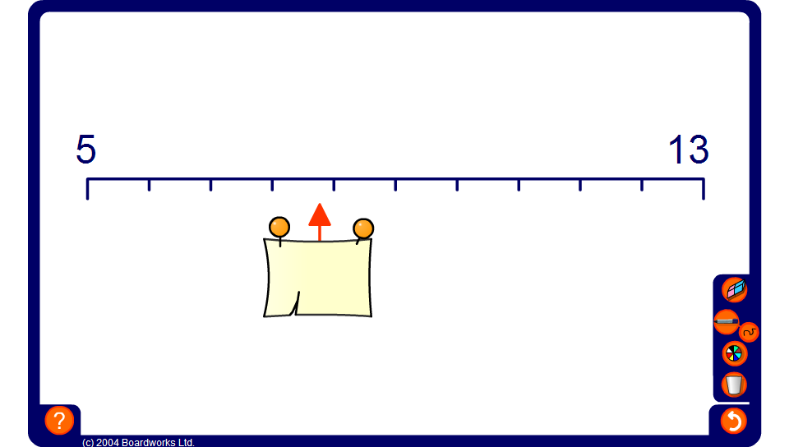


Estimating points on a scale
Notes:
The scale has ten divisions so start by establishing the value of each division by finding the difference between the numbers shown and dividing by 10.
Ask pupils to suggest estimates by counting on or back from one of the end points.
Click to reveal the answer.
Link:
S7 Measures – reading scales.

